Slide 1
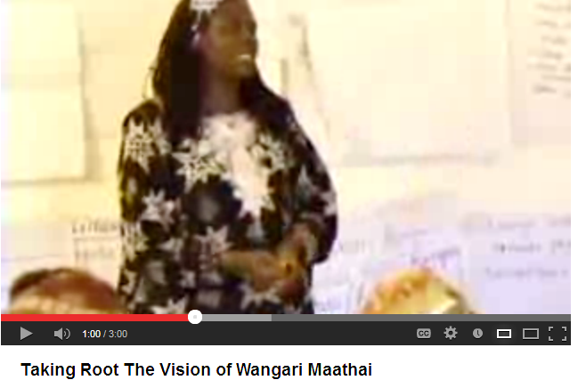
Wangari Maathai

Slide 2
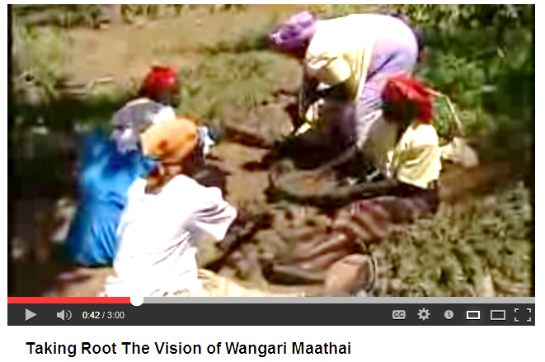
Planting Trees

Slide 3
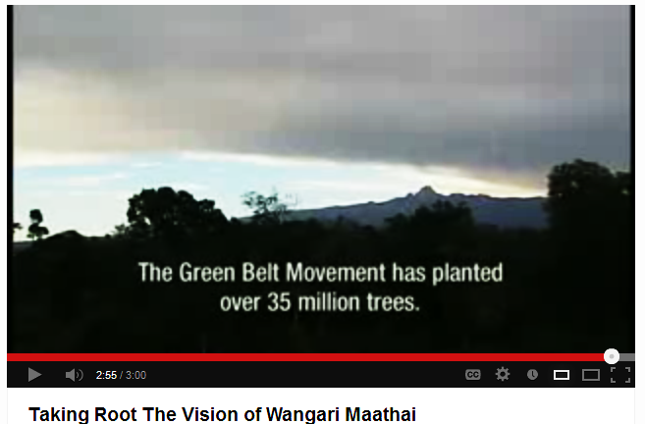
Greenbelt Movement

Slide 4
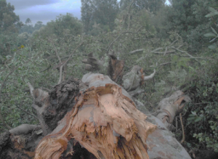

Slide 5
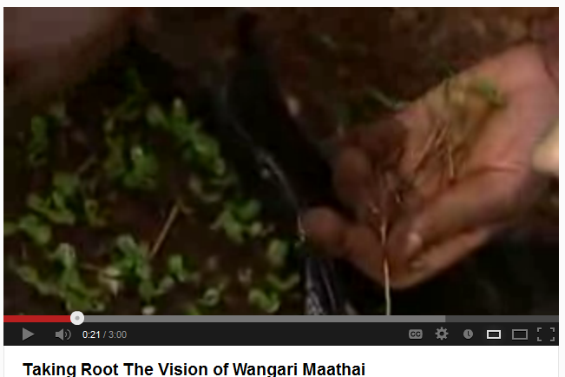
Tiny Seedlings

Slide 7
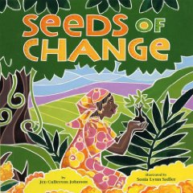

Slide 8
Friday, February 8, 2013 - 00:00 – BY WAMBUGU KANYI An elder in Nyeri has interpreted the felling of a 300-year-old Mugumo tree by heavy rains in Nyeri politically. Harrison Kanyuguto, a village elder in Giakanja, said the breaking of the tree into two halves means that old politicians should hand over power to a younger generation and vice-versa. Kanyuguto said the Mugumo tree was once used in the 1880s as a sanctuary by his great grandfathers when praying for rains. He said their prayers would always be answered. Kanyugoto, 80, said traditions stipulate that the tree cannot be used for firewood but should instead be left to rot on its own. According to the Kikuyu culture, the Mugumo is a sacred tree that should never be cut down. The tree was used by elders as a shrine where prayers were held. Another Mugumo tree must be planted at the same point where the previous one stood to avoid a curse befalling the community. Gichuki Irungu, the owner of the shamba where the Mugumo tree stood, said he is yet to decide what they will do with the tree because he does not know what may befall his family. Irungu said he will seek advice from elders on what he should do with it. He said he will sell it for firewood if the elders approve of it. However, Njeri Irungu, Gichuki's relative, said she will never cut any part of the tree because it may put her family to great danger.

